Slide 1
Post-Optimality Analysis using Merton Trucks
Sessions 5 – 6
Accelerated General Management Program
2020 Session

Slide 2
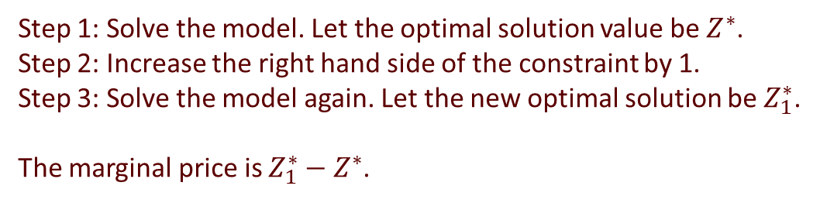
Computing marginal prices
Step 1: Solve the model. Let the optimal solution value be $Z^{∗}$.
Step 2: Increase the right hand side of the constraint by 1.
Step 3: Solve the model again. Let the new optimal solution be $Z_{1}^{∗}$.
The marginal price is $Z_{1}^{∗}−Z^{∗}$.
Resource | Availability
Engine Assembly | 4000 hrs
Metal Stamping | 6000 hrs
101 Assembly | 5000 hrs
102 Assembly | 4500 hrs
Resource | Availability
Engine Assembly | 2500 hrs
Metal Stamping | 6000 hrs
101 Assembly | 5000 hrs
102 Assembly | 4500 hrs
Resource | Availability
Engine Assembly | 4000 hrs
Metal Stamping | 4000 hrs
101 Assembly | 3000 hrs
102 Assembly | 4500 hrs
$2000 / hr
$2500 / hr
$0 / hr

Slide 3
A new look “Table A”
Changed the unit of measurement to the total capacity of each resource
Resource | Model 101 | Model 102 | Availability
Engine Assembly | 0.00025 | 0.00050 | 1
Metal Stamping | 0.00033 | 0.00033 | 1
Model 101 Assembly | 0.00040 |  | 1
Model 102 Assembly |  | 0.00067 | 1
Resource | Model 101 | Model 102 | Availability
Engine Assembly | 1/4000 | 2/4000 | 1
Metal Stamping | 2/6000 | 2/6000 | 1
Model 101 Assembly | 2/5000 |  | 1
Model 102 Assembly |  | 3/4500 | 1
Resource | Model 101 | Model 102 | Availability
Engine Assembly | 1 | 2 | 4000
Metal Stamping | 2 | 2 | 6000
Model 101 Assembly | 2 |  | 5000
Model 102 Assembly |  | 3 | 4500
What is a fool-proof way to compute the marginal worth of the engine assembly resource?

Slide 4







Marginal price of engine assembly
Engine assembly
Metal stamping
101 assembly
102 assembly
$$p_{EA}$$
$$p_{MS}$$
$$p_{101}$$
$$p_{102}$$
In resource bundle for manufacturing 101s
Generates
$3000
$${2p}_{EA}+2p_{MS}+2p_{101}≥3000$$
In resource bundle for manufacturing 102s
Generates
$5000
$${2p}_{EA}+2p_{MS}+3p_{102}≥5000$$
Generates
$0
Lying idle
$${2p}_{EA}+2p_{MS}+3p_{102}≥0$$

Slide 5

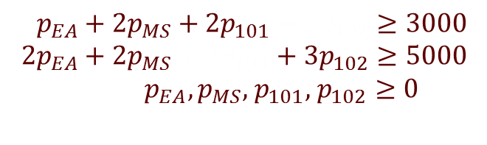



Marginal prices of all resources
Shadow
Maximize $3000m_{1}+5000m_{2}$
Minimize (the price of $ε$ portion of resources)
$$ε(4000p_{EA}+6000p_{MS}+5000p_{101}+4500p_{102})$$
$$4000p_{EA}+6000p_{MS}+5000p_{101}+4500p_{102}$$
Subject to
Subject to
$$2m_{1}+2m_{2}≤4000 \\ 2m_{1}+2m_{2}≤6000 \\ 2m_{1}+3m_{2}≤5000 \\ 2m_{1}+3m_{2}≤4500$$ $m_{1},m_{2}≥0$
$$2p_{EA}+2p_{MS}+2p_{101}+3p_{102}≥3000 \\ 2p_{EA}+2p_{MS}+2p_{101}+3p_{102}≥5000$$ $p_{EA},p_{MS},$ $p_{101},$ $p_{102}≥0$
(Since $ε$ is constant.)
DUAL
PRIMAL

Slide 6
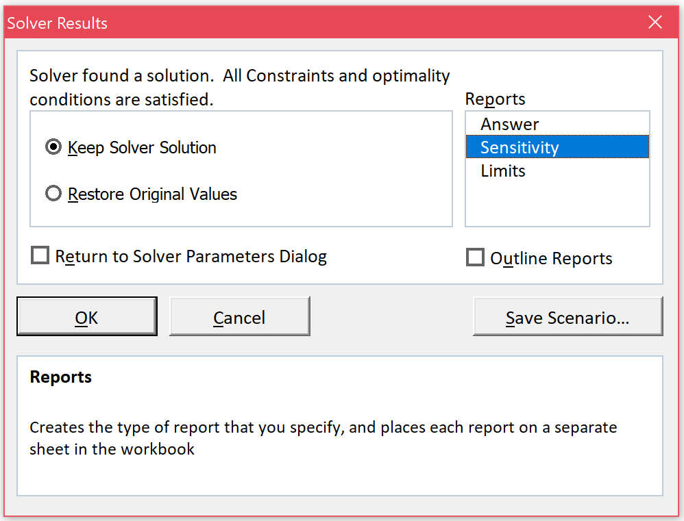
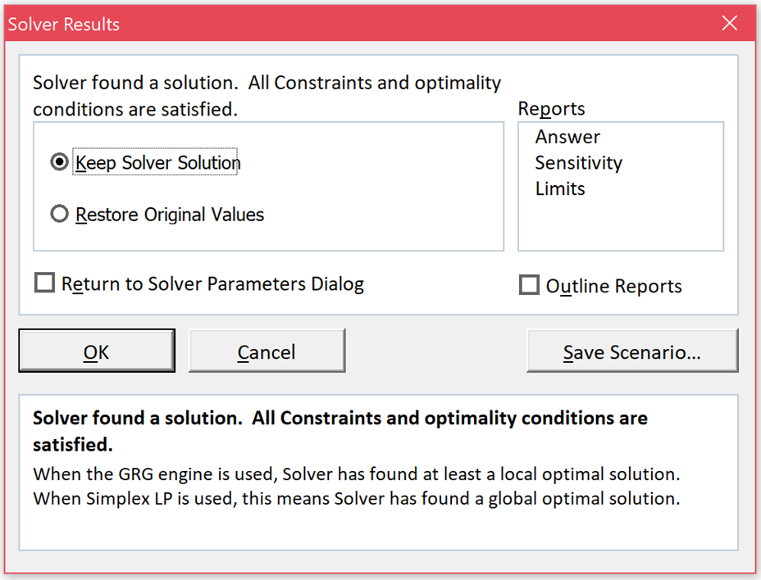
Sensitivity analysis with Excel

Slide 7
Sensitivity analysis with Excel
Variable Cells
 |  |  | Final | Reduced | Objective | Allowable | Allowable
 | Cell | Name | Value | Cost | Coefficient | Increase | Decrease
 | $B$2 | Product Mix 101s | 2000 | 0 | 3000 | 2000 | 500
 | $C$2 | Product Mix 102s | 1000 | 0 | 5000 | 1000 | 2000
Constraints
 |  |  | Final | Shadow | Constraint | Allowable | Allowable
 | Cell | Name | Value | Price | R.H. Side | Increase | Decrease
 | $E$7 | Engine Assembly | 4000 | 2000 | 4000 | 500 | 500
 | $E$8 | Metal Stamping | 6000 | 500 | 6000 | 500 | 1000
 | $E$9 | Model 101 Assembly | 4000 | 0 | 5000 | 1E+30 | 1000
 | $E$10 | Model 102 Assembly | 3000 | 0 | 4500 | 1E+30 | 1500

Slide 8
Sensitivity analysis with Excel
If you left the solution method as GRG Nonlinear you would get this table

Slide 9
Sensitivity report
Variable Cells
 |  |  | Final | Reduced | Objective | Allowable | Allowable
 | Cell | Name | Value | Cost | Coefficient | Increase | Decrease
 | $B$2 | Product Mix 101s | 2000 | 0 | 3000 | 2000 | 500
 | $C$2 | Product Mix 102s | 1000 | 0 | 5000 | 1000 | 2000
Constraints
 |  |  | Final | Shadow | Constraint | Allowable | Allowable
 | Cell | Name | Value | Price | R.H. Side | Increase | Decrease
 | $E$7 | Engine Assembly | 4000 | 2000 | 4000 | 500 | 500
 | $E$8 | Metal Stamping | 6000 | 500 | 6000 | 500 | 1000
 | $E$9 | Model 101 Assembly | 4000 | 0 | 5000 | 1E+30 | 1000
 | $E$10 | Model 102 Assembly | 3000 | 0 | 4500 | 1E+30 | 1500
Cell containing the formula for the LHS of the constraint.
Value of the LHS of the constraint at the optimum.
Value you had for the RHS of the constraint.

Slide 10
Sensitivity analysis
Lower tolerance (allowable decrease)
Upper tolerance (allowable increase)
The set of constraints with no
slack/surplus remains the same
Parameter value
Lower tolerance limit
At this value of the parameter, there is a set of constraints that are tight (no slack/surplus)
Upper tolerance limit
e.g., an objective function coefficient or a right hand side value
In this analysis
Only one parameter value changes at a time.
The set of constraints that define an optimum solution should not change.

Slide 11
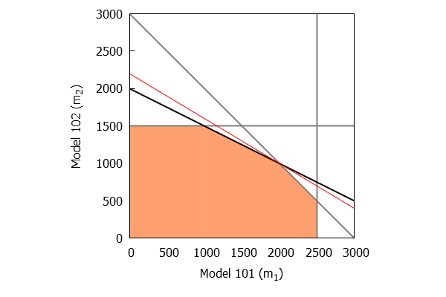
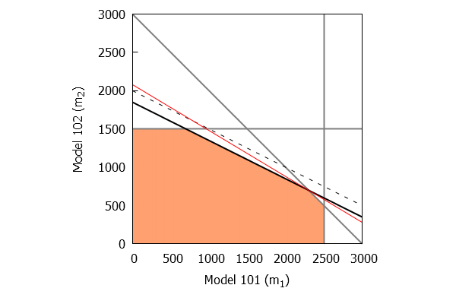
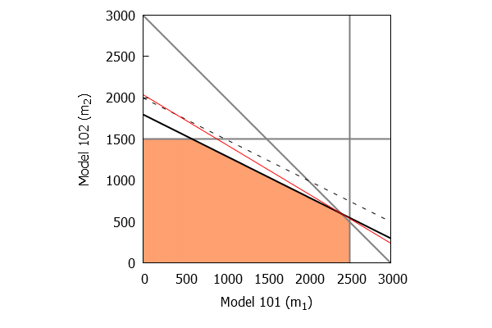
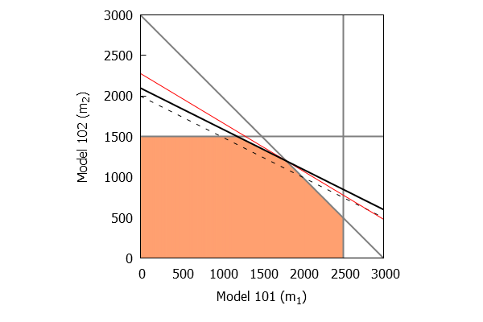
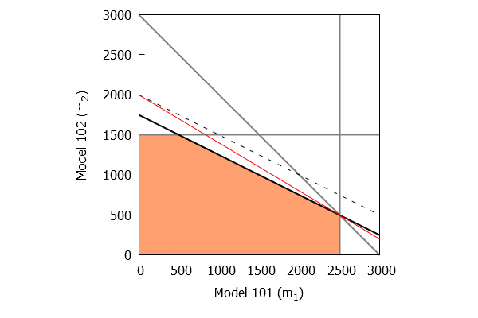
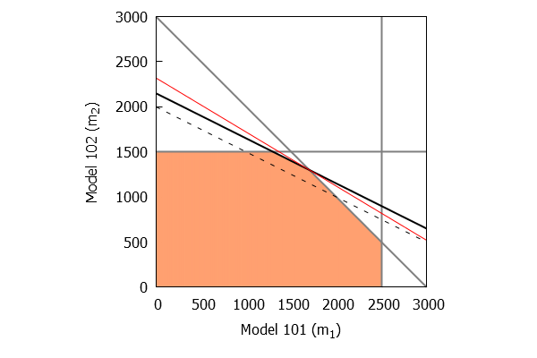
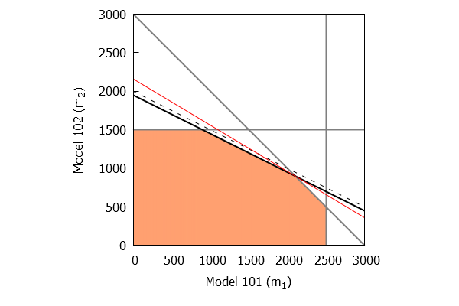
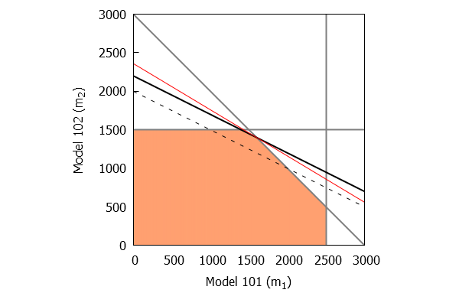
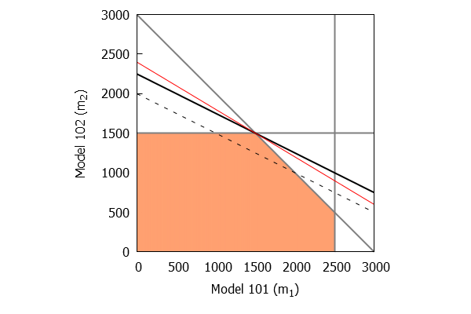
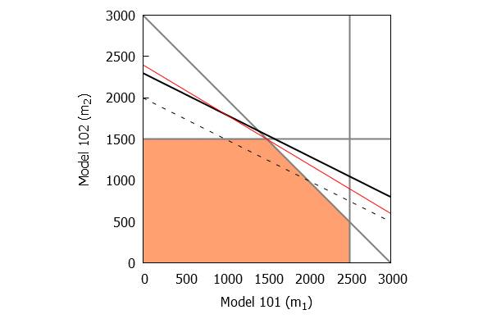
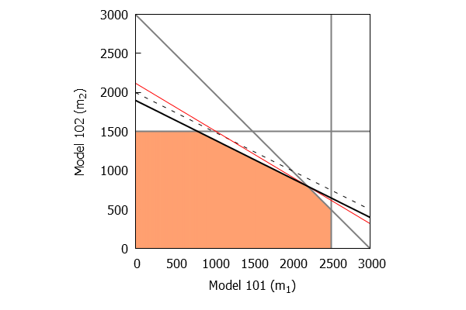
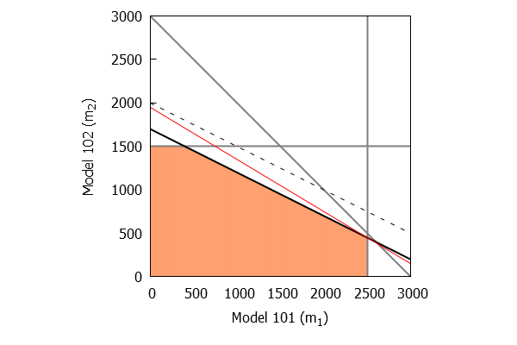
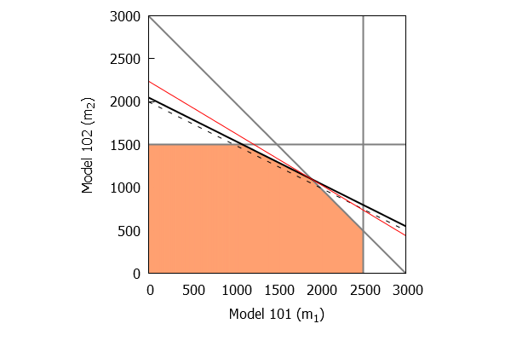
Changing right hand side values
Engine Assembly
Feasible region : Changes
Optimal solution : Changes
Optimal solution value : Changes
Shadow prices : Remains same
Set of binding constraints : Remains same
3500
4000
4500
Engine assembly capacity
allowable decrease
= 500
allowable
increase
= 500

Slide 12
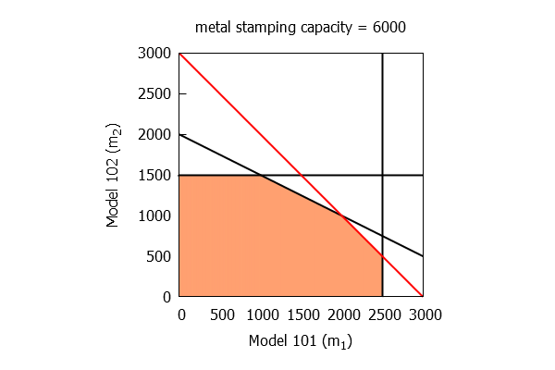
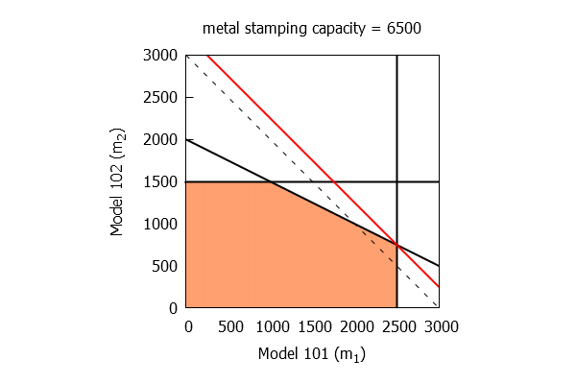
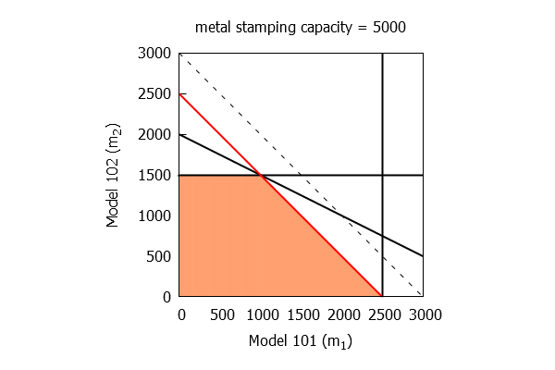


Changing right hand side values
Metal Stamping
Allowable increase: $6500 – 6000 = 500$
Allowable decrease: $6000 –5000 =1000$

Slide 13
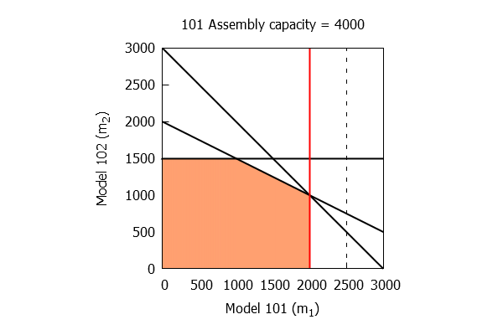
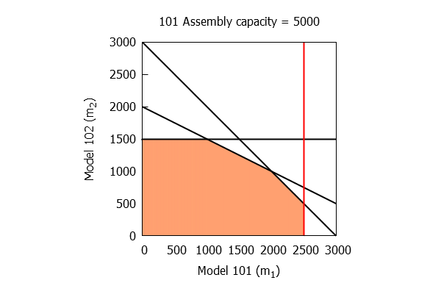

Changing right hand side values
Model 101 Assembly
Allowable increase: infinite
Allowable decrease: $5000 –4000 =1000$

Slide 14
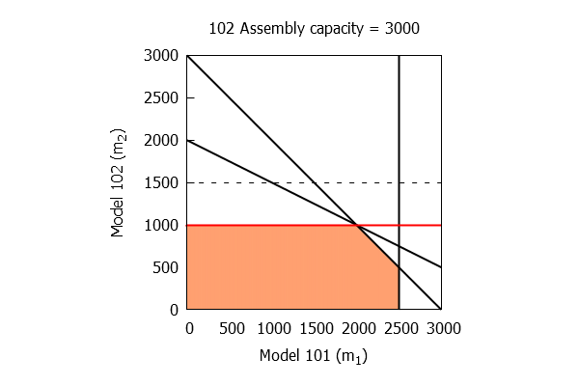


Changing right hand side values
Model 102 Assembly
Allowable increase: infinite
Allowable decrease: $4500 –3000 =1500$

Slide 15
Sensitivity report
Variable Cells
 |  |  | Final | Reduced | Objective | Allowable | Allowable
 | Cell | Name | Value | Cost | Coefficient | Increase | Decrease
 | $B$2 | Product Mix 101s | 2000 | 0 | 3000 | 2000 | 500
 | $C$2 | Product Mix 102s | 1000 | 0 | 5000 | 1000 | 2000
Constraints
 |  |  | Final | Shadow | Constraint | Allowable | Allowable
 | Cell | Name | Value | Price | R.H. Side | Increase | Decrease
 | $E$7 | Engine Assembly | 4000 | 2000 | 4000 | 500 | 500
 | $E$8 | Metal Stamping | 6000 | 500 | 6000 | 500 | 1000
 | $E$9 | Model 101 Assembly | 4000 | 0 | 5000 | 1E+30 | 1000
 | $E$10 | Model 102 Assembly | 3000 | 0 | 4500 | 1E+30 | 1500
Amount by which the RHS of the constraint can increase before the shadow price values change.
Amount by which the RHS of the constraint can decrease before the shadow price values change.

Slide 16
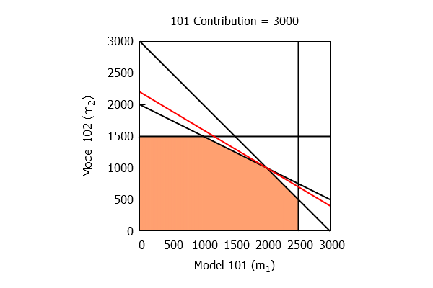
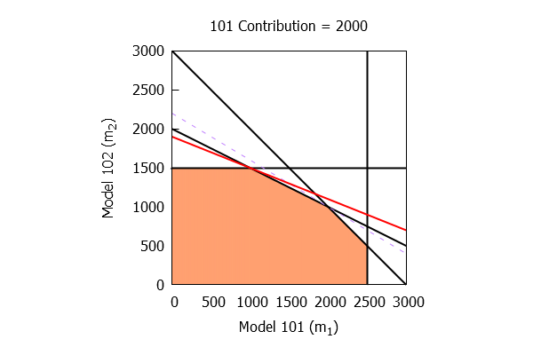
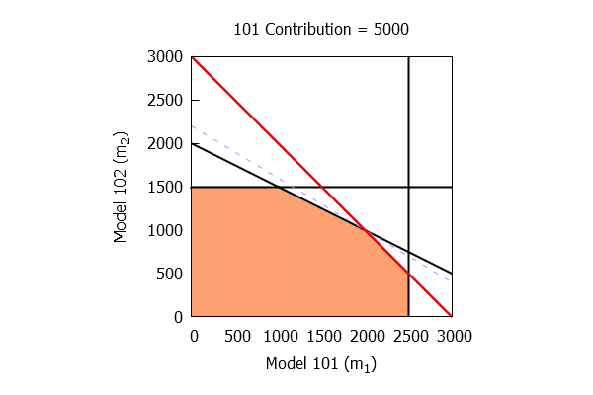
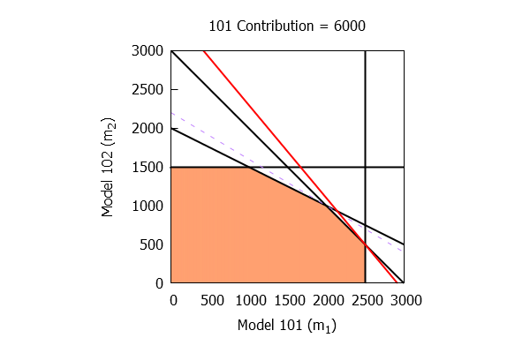


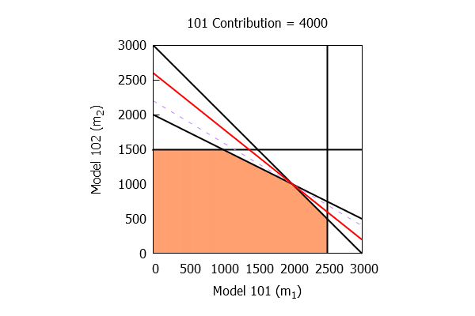

Changing objective function coefficients
Model 101
Feasible region : Remains same
Optimal solution : Remains same
Optimal solution value : Changes
Shadow prices : Change
Set of binding constraints : Remains same
2500
5000
3000
Contribution from Model 101
allowable decrease
= 500
allowable
increase
= 2000

Slide 17

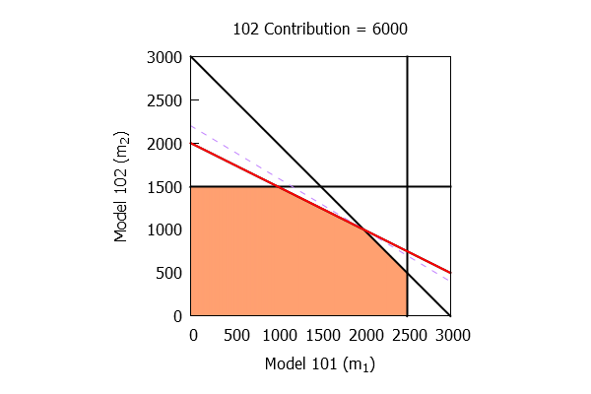



Changing objective function coefficients
Model 102
Allowable increase: $6000 –5000 =1000$
Allowable decrease: $5000 –3000 =2000$

Slide 18
Sensitivity report
Amount by which the corresponding coefficient can increase before the optimum solution changes.
Amount by which the corresponding coefficient can decrease before the optimum solution changes.
The optimum solution.
Variable Cells
 |  |  | Final | Reduced | Objective | Allowable | Allowable
 | Cell | Name | Value | Cost | Coefficient | Increase | Decrease
 | $B$2 | Product Mix 101s | 2000 | 0 | 3000 | 2000 | 500
 | $C$2 | Product Mix 102s | 1000 | 0 | 5000 | 1000 | 2000
Constraints
 |  |  | Final | Shadow | Constraint | Allowable | Allowable
 | Cell | Name | Value | Price | R.H. Side | Increase | Decrease
 | $E$7 | Engine Assembly | 4000 | 2000 | 4000 | 500 | 500
 | $E$8 | Metal Stamping | 6000 | 500 | 6000 | 500 | 1000
 | $E$9 | Model 101 Assembly | 4000 | 0 | 5000 | 1E+30 | 1000
 | $E$10 | Model 102 Assembly | 3000 | 0 | 4500 | 1E+30 | 1500
Coefficients in the objective function.

Slide 19
Question 3(b) – Minimum price for 103s to be produced in an optimal solution
Approach 1:
Force Merton Trucks to produce at least one Model 103 truck and see how suboptimal their solution is. Increase the contribution from Model 103s to compensate for the suboptimality.
Approach 2:
Find the worth of resources going into making of a Model 103. You require at least this amount of contribution to consider making a Model 103 in your optimal product mix.

Slide 20
Sensitivity report
Amount by which the objective function coefficient must be decreased before the corresponding variable has a non-zero value in an optimal solution.
Sensitivity Report including Model 103s

